Slide 1
Introduction to CSS – Part 1
Exercise 2

Slide 2
Cascading Style Sheets (CSS)
Describes how HTML elements should be rendered on a given media

Slide 3
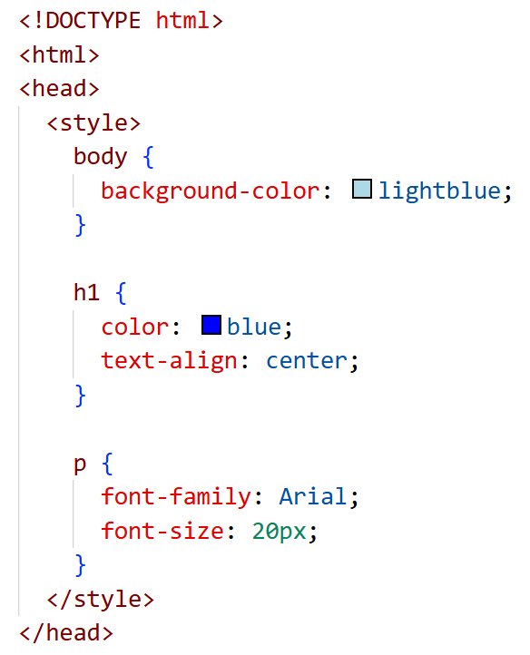
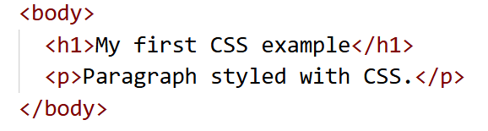
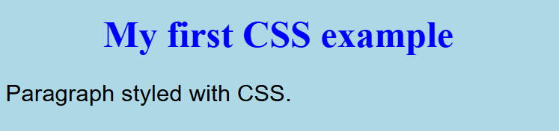
CSS – example

Slide 4
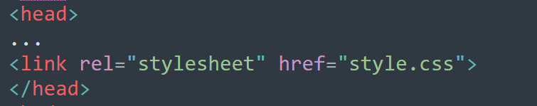
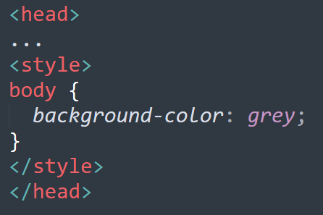
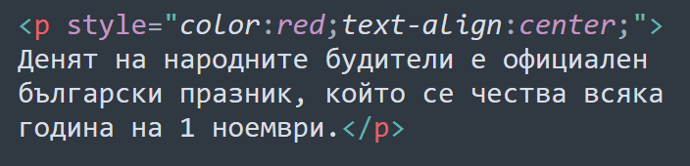
How to add CSS?
External CSS
Internal CSS
Inline CSS

Slide 5
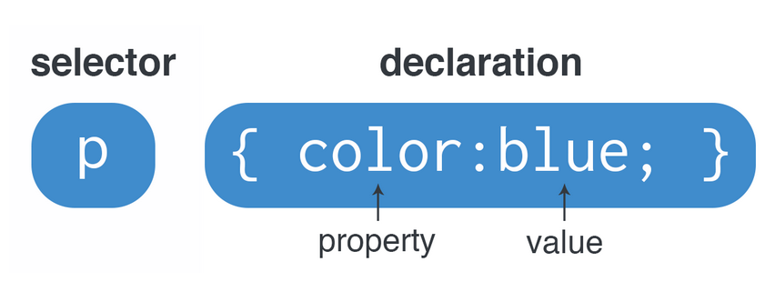
Syntax

Slide 6
Selectors
Simple selectors
Combinator selectors
Pseudo-class and pseudo-elements selectors
Attribute selectors

Slide 7
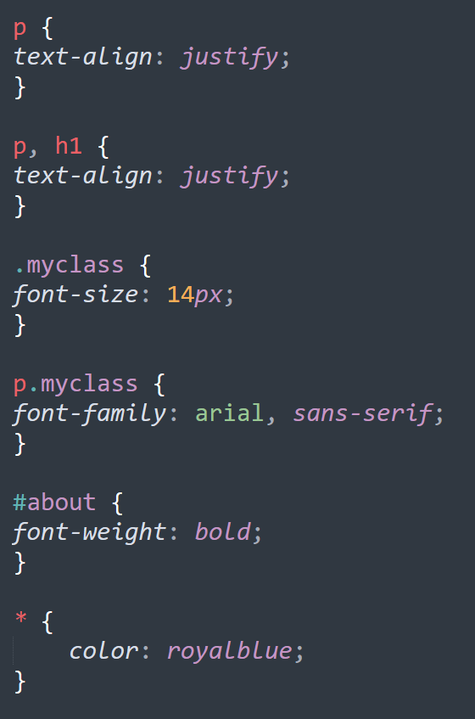
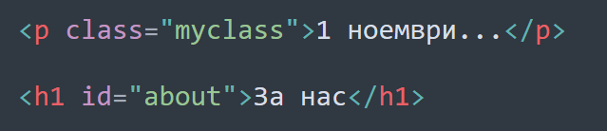
Simple selectors
Based on the name of the tag
Based on class to set styling with multiple applications
Based on id to style a specific element
Universal selector *

Slide 8
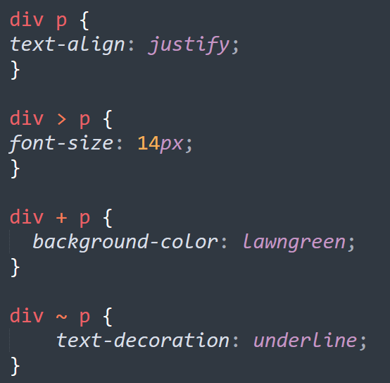
Combinator selectors
div p - selects all paragraphs nested in a <div> container
div > p - selects all paragraphs nested at the first level in a <div> container
div + p - selects a <p> element that is immediately after a <div>
div ~ p - selects a <p> element that is preceded by a <div> and both elements have the same parent element

Slide 9
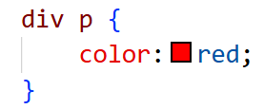
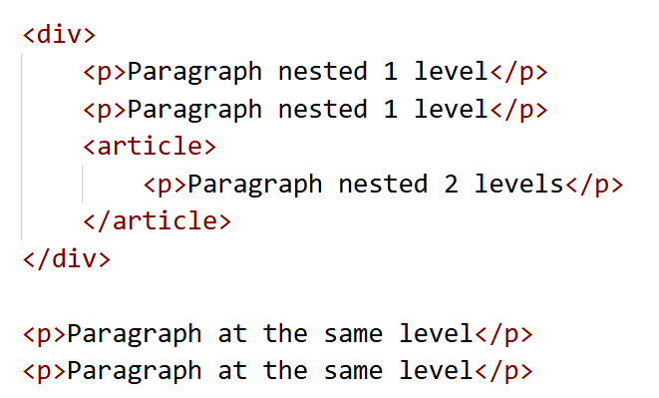
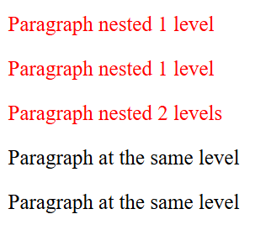
Combinator selector div p
Selects all paragraphs nested in a <div> container

Slide 10
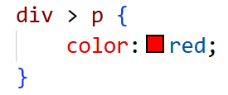
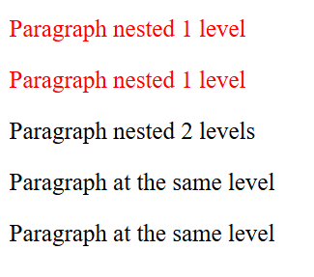
Combinator selector div > p
Selects all paragraphs nested at the first level in a <div> container

Slide 11
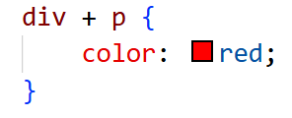
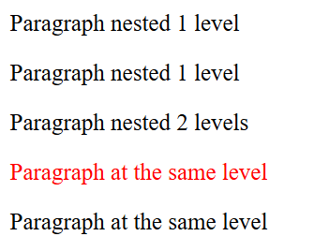
Combinator selector div + p
Selects a <p> element that is immediately after a <div>

Slide 12
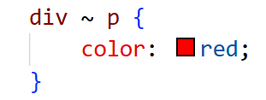
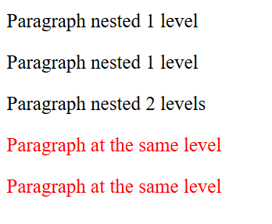
Combinator selector div ~ p
div ~ p – selects a <p> element that is preceded by a <div> and both elements have the same parent element

Slide 13
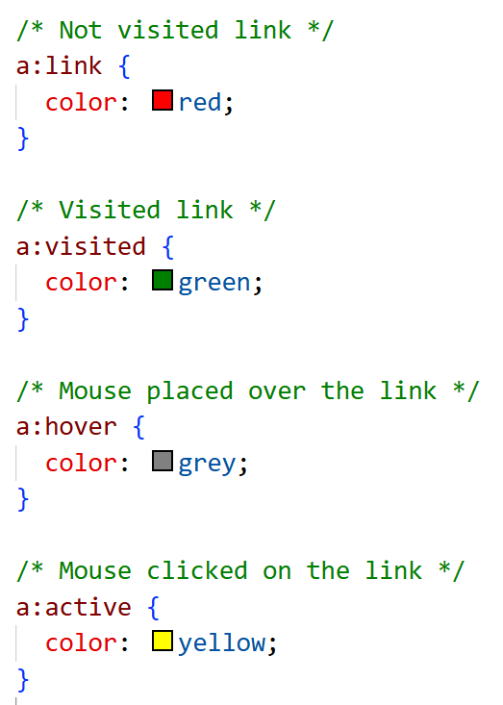
Pseudo-selectors
For state (pseudo-classes) - the style is applied to the element based on its state;
For pseudo-elements, defining part of an element

Slide 14

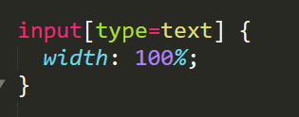
Attribute selectors
Selects elements with specified attributes and their values

Slide 15
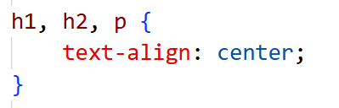
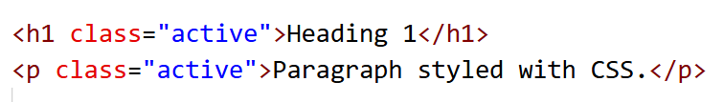
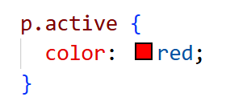
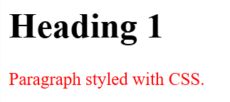
Grouping selectors

Slide 16
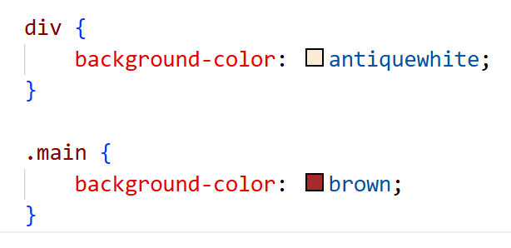
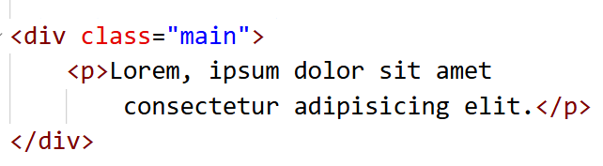
Priorities for applying styling
Cascading is a mechanism by which the browser decides which value of a given property to apply when there is more than one rule that sets it.
Four main pillars:
Origin and importance
Cascading layers (@layer)
Specificity
Order of appearance
Property inheritance

Slide 17
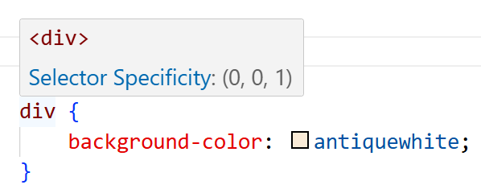
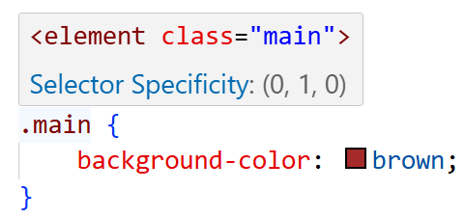
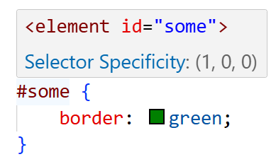
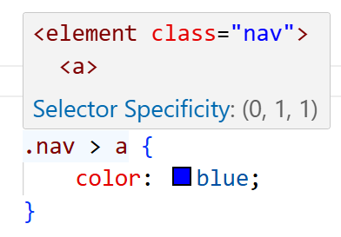
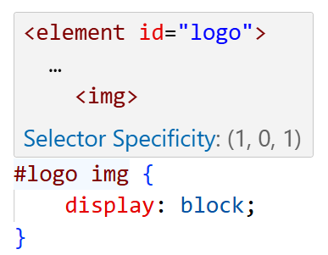
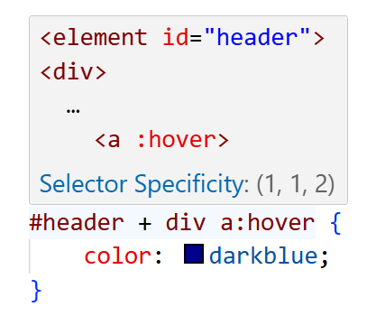
Specificity
Specificity is a numerical "weight" of the selector.
4 positions: a, b, c and d
a – inline styles (in the element: style="...") (1,0,0,0)
b – number of id selectors (0,1,0,0)
c – number of class, attribute selectors and pseudo-classes (0,0,1,0)
d – number of elements and pseudo-elements (0,0,0,1)
Universal selector * - specifity (0,0,0,0)

Slide 18
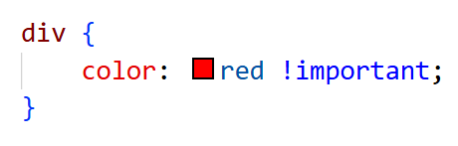
!important
!important is a declaration that gives the highest priority to a given CSS property.
When used, it overrides all other values ​​for the same property, regardless of specificity or code order.

Slide 19
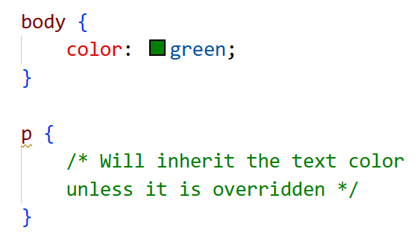
Inheritance
Inheritance is the mechanism by which some CSS properties are automatically passed from a parent element to its children.
If a property is inheritable, its value is also applied to nested elements unless they have overridden it.
Inherited properties: e.g. font properties (font-family, font-size, font-style, font-weight), text (color, line-height, text-align)…
Non-inherited properties: e.g. layout and size (margin, padding, border, width, height, background…)

Slide 20
Declarations
Property: value;

Slide 21
Some declarations for testing selections
Text:
font-size: 16px; - font size
font-style: italic; - italic
font-weight: bold; - bold
color: red; - text color
text-align: left | right | center | justify | initial | inherit; - text alignment
Background:
background-color: green;
background-image: url(“myimage.gif");
Marker of the list item element:
list-style-type: disc | circle | square;
list-style-type: decimal | decimal-leading-zero | lower-alpha | upper-alpha | lower-latin | upper-roman | none | ….;

Slide 22
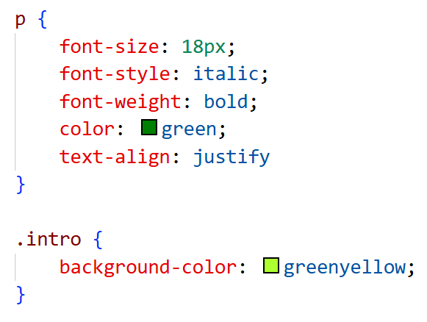
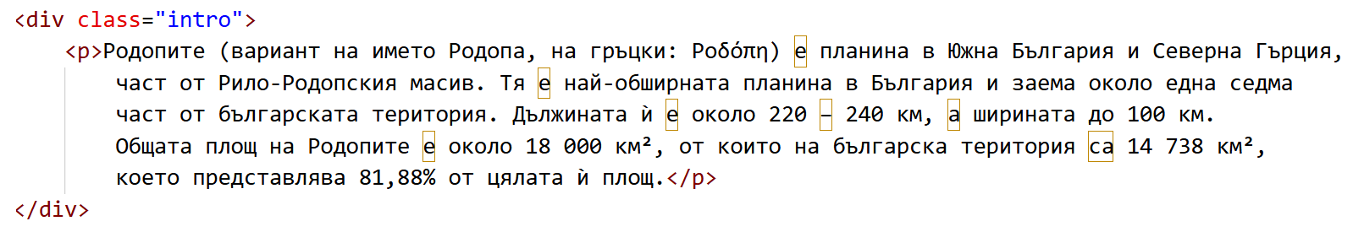
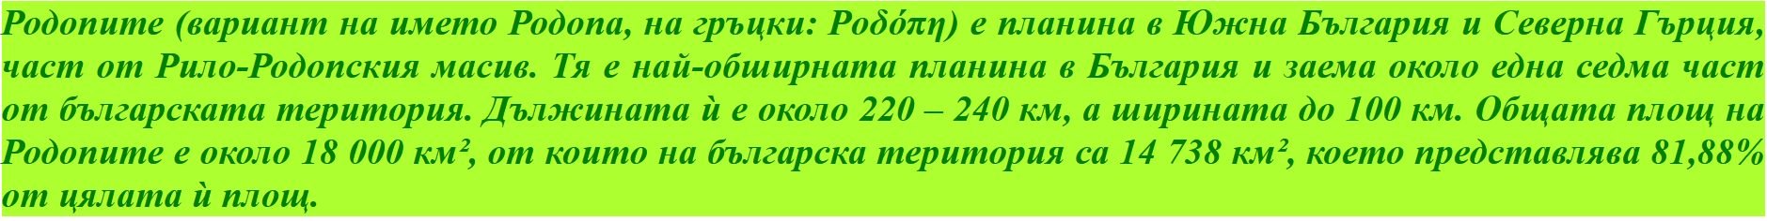
Example

